Slide 1
HSV Color Model By Jayasree V 2023510026

Slide 2
What is color?
The word "color" refers to the visual perception created by the way an object reflects or emits light. It's how our eyes and brain interpret different wavelengths of light.
Color is a property of light determined by its wavelength in the visible spectrum
For example:
Red: ~620–750 nm
Green: ~495–570 nm
Blue: ~450–495 nm

Slide 3
What is color model?
A COLOR MODEL CAN BE DEFINED AS A SYSTEM,WHICH MAKES USE OF THE THREE PRIMARY COLORS(RGB),TO PRODUCE A VAST RANGE OF COLORS.THERE are many color models used in the technology sector and each of them have certain purposes and different from each other.the range of colors which can be produced by deploying any particular color model is referred technically as a color space.
The different color models are:
-rgb
-cmy
-hsv
-YIQ

Slide 4
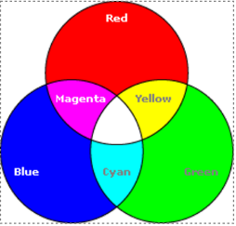
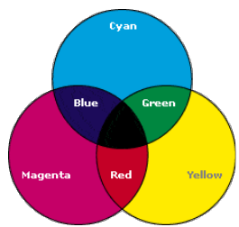
RGB and CMY color model:
These are the primary colors of light, and by mixing them at different intensities (usually from 0 to 255), we can create millions of colors.
R-Red
G-Green
B-Blue
Primary colors are used to produce the secondary colors as and when required
There are two color model-Additive and Subtractive models.
It is a subtractive color model, which means it works by removing light from white
C-Cyan
M-Magenta
Y-Yellow

Slide 5
What is HSV color model?
H-The type of color
S-How strong or pure the color is
V-How bright or dark the color is
H-Hue
Hue(H) is the angle around the vertical axis.
S-Saturation
Saturation(S) is a value from 0 to 1 indicating how far from the vertical axis the color lies.
V-Value
Value(V) is the height of the hexcone.

Slide 6
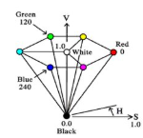
HSV color model
HUE | SATURATION | VALUE | COLOR
0 | 1.0 | 1.0 | Red
120 | 1.0 | 1.0 | Green
240 | 1.0 | 1.0 | Blue
* | 0.0 | 1.0 | White
* | * | 0.0 | Black

Slide 7
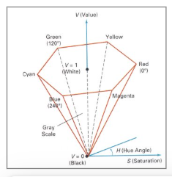
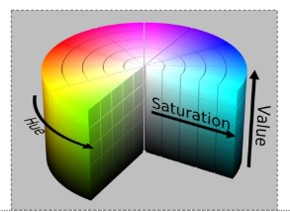
Hue,Saturation,Value:Cylinder!

Slide 8
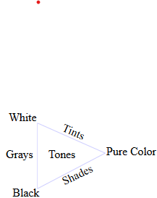
How do Artists do it?
Artists often specify color as tints,shades and tones of saturated(pure) pigments.
Tint:gotten by adding white to a pure pigment,decreasing saturation.
Shade:gotten by adding black to a pure pigment,decreasing lightness.
Tone:gotten by adding white and black to a pure pigment.

Slide 9
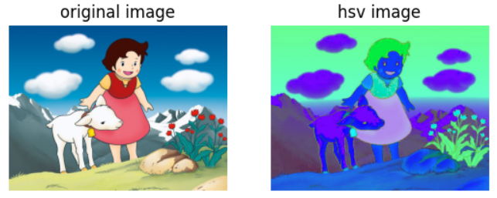

Slide 10
Why is HSV used?
It separates the color itself from the brightness and intensity
It makes it easier to detect and filter colors in image.
It works when lighting changes(like shadow or brightness).
Why HSV is often preferred over RGB?
Separation of color and intensity.
HSV separates color (hue) from brightness (value) and colorfulness (saturation).
RGB mixes color and brightness, making it hard to isolate just the hue or shade.

Slide 11
Where is HSV used?
Image Processing (computer vision)
Object Tracking
Color Pickers
Skin or face detection
Underwater or low-light color detection

Slide 12
Thank you !!!

